Slide 1
Test 2 Slide Set 1

Slide 2
Command Line Parameters
CSCE 121
J. Michael Moore

Slide 3
Passing parameters to Programs
Happens all the time
Double click filename

Slide 4
Things to remember
argc
Argument count
Total number of parameters (includes program name)
Separated by spaces.
How to input a string with a space?
argv
Argument values
Array with each argument as an element
argv[0] is ALWAYS the name of the program
Pointers involved, frequently easier to assign to a string and then use the string

Slide 5
Programmer defines rules
If arguments do not follow rules:
Output usage information (i.e. help/feedback)
Exit program
Don’t prompt for new data…
Use of command line parameters can be quite sophisticated
Flags
Provide specific information
Frequently prepended with a dash, e.g. –al
Unix/Linux command line

Slide 6
Exceptions with Functions
CSCE 121
J. Michael Moore
Based on slides created by Carlos Soto.
Notes:
Lets first recall how exceptions work

Slide 7
Recall
3 parts
throw
try
catch

Slide 8
When an exception is thrown
Function stops executing immediately
Scan down looking for a catch
Either
Catch block found
If type matches thrown object
Execute catch block
Resume execution after catch block(s) (not back to where throw happened)
Else continue scan (note there might be another catch immediately)
End of function reached

Slide 9
When an exception is thrown
End of function reached
Remove function from call stack
Variables go out of scope
Includes calling destructors (for example, file streams will close their files)
If the function removed from stack is main, the program terminates
Throw exception to calling function
Return to function where call occurred
Scan down looking for a catch (i.e. go back to main step 2)
Exceptions propagate down
call stack until caught or
program terminates.

Slide 10
Separation of Concerns
Recall that a function should do one thing well.
What to do when a function gets bad data?
Temptation: Do cout/cin to get a replacement value.
Not all programs are interactive.
What if the data is from a censor?
What if the interactive program is using another language?
Action: Throw exception
Function identifies error and throws an exception.
Elsewhere in the program the exception is caught and handled.
Avoid mixing I/O with another action within a function.

Slide 11
Exceptions
Stops execution immediately
when throw occurs.
try {
// ...
if (problem)
throw runtime_error("problem");
// ...
}
catch ( ) {
// handle exception
}
does not get executed
runtime_error &e
Notes:
… what gets thrown is an object, in this case the standard runtime exception runtime_error

Slide 12
Throwing/Catching in same function
void myfunction () {
try {
if (problem)
throw runtime_error("problem");
}
catch(runtime_error &e) {
}
}
Generally NOT done.
Handle in else part of if statement.
Notes:
Not a very clean way to program. In fact, as a rule, we usually don’t want exception handling the functions we’ve designed to do something else.

Slide 13
Throwing in a function
void myfunction () {
// ...
if (problem)
throw runtime_error("problem");
// ...
}
Function only has
to identify issue,
not resolve it.
Notes:
Something C++ allows is for exceptions to propagate up the call stack. That means that we don’t have to catch our exceptions in the same function, so we don’t need the try block either.

Slide 14
Catching in calling function
void myfunction () {/* throws exception */ }
int main () {
try {
myfunction();
}
catch (runtime_error &e) { // handle error
}
}
Deal with problem
where it can be addressed.
Notes:
We can catch our exception in the calling function.

Slide 15
Propagation of exception down call stack
void myfunction () {/* throws exception */ }
void second_function() {
myfunction()
}
int main () {
try {
second_function();
}
catch (runtime_error &e) { // handle error
}
}
You should catch it somewhere.
If it propagates past main,
program will crash!
Notes:
You can actually catch it anywhere up the call stack. And you NEED to catch it somewhere though, or you’ll get an unhandled exception, which will crash your program.

Slide 16
Function Overloading
CSCE 121
J. Michael Moore
Based on slides created by Carlos Soto.
Notes:
Today I’m going to talk about two related topics relating to functions: Overloading, and default parameters.
I made some badass animations, so pay attention.

Slide 17
Recall
Declaration
return_type name (formal arguments);
int sum(const vector<int>& vals);
Note, the declaration does NOT need names for the formal arguments.
int sum(const vector<int>&); // acceptable in declaration
Why?
Compiler only needs this information to find the function definition that corresponds to it.

Slide 18
Function Signature
Unique combination of
Name and parameter types and parameter order.
Frequently equated with the declaration.
However, it is possible to have different declarations that are considered the same signature.
int mean(int a, int b);
int mean(int first, int last);
double mean(int, int);
Not allowed: Same signature, i.e. mean with two int parameters.
Not allowed:
cannot differ by return type alone

Slide 19
Compiler
The compiler tries to match function calls to a signature that matches a declaration it has already seen.
Note: The compiler starts at the top of the file containing main() and works its way down.
This is why functions must be declared above where they are called in a program.
#include essentially puts declarations at the top of the file.

Slide 20
Overloading
Essentially creating multiple functions with
The same name
Different parameter configurations
Number of parameters
Types of parameters
Order of parameter types
Only overload if the functions do very similar things!

Slide 21
Overloading Guidelines
If you want functions that:
Have completely different logic
Have similar logic, and can work for different datatypes
Use different function names
Use function overloading

Slide 22
Default Parameters
February 24, 2016
Based on slides created by Carlos Soto.

Slide 23
Common Parameter Values
Sometimes, one particular value for a parameter is so common, that alternatives are rarely used.
It would be convenient if the common value could be omitted most of the time.

Slide 24
Example Situations
Print a vector:
Normal: first to last
Sometimes: last to first
Get average:
Normal: Round
Sometimes: Truncate
Debug information:
Normal: do not include
Sometimes: include
Output filename:
Normal: default name
Sometimes: provide

Slide 25
Default Parameters
double mean(int a, int b, bool truncate)
{
if (truncate) {
return (a + b) / 2;
// integer division truncates
}
else {
return (a + b) / 2.0;
}
}
Notes:
All we’d have to do is set our

Slide 26
Default Parameters
double mean(int a, int b, bool truncate = false)
{
if (truncate) {
return (a + b) / 2;
// integer division truncates
}
else { // normal
return (a + b) / 2.0;
}
}
Notes:
All we’d have to do is set our

Slide 27
Calling a function with a default parameter
int mean(int a, int b, bool truncate = false) {
// ...
}
int main () {
int val1 = 25, val2 = -71;
double normal_avg = mean(val1, val2, false)
double trunc_avg = mean(val1, val2, true);
}
Not needed!
Notes:
We could still include the round flag in both calls of the mean function, but now we can do something else too…

Slide 28
Calling a function with a default parameter
int mean(int a, int b, bool truncate = false) {
// ...
}
int main () {
int val1 = 25, val2 = -71;
double normal_avg = mean(val1, val2)
double trunc_avg = mean(val1, val2, true);
}
Works the same!
Notes:
We could still include the round flag in both calls of the mean function, but now we can do something else too…

Slide 29
Function Signature
Recall that the function signature is based on the name of the function and the configuration of the parameters.
Adding default parameters causes a single function to have multiple signatures.
int mean(int a, int b, bool truncate = true);
Signature 1: int mean(int, int, bool)
Signature 2: int mean(int, int)

Slide 30
If declaring and defining separately…
Only indicate default value in declaration.
int mean(int a, int b, bool truncate = false);
int main () {
int val1 = 25, val2 = -71;
double normal_avg = mean(val1, val2)
double trunc_avg = mean(val1, val2, true);
}
int mean(int a, int b, bool truncate); {
// ...
}
Otherwise, compiler will not recognize.
Compiler error if default value is also included in definition.
Notes:
We could still include the round flag in both calls of the mean function, but now we can do something else too…

Slide 31
Notes on default parameters
Often used to set a single flag for a function
Good for functions that logically work with fewer parameters
More than one parameter can be default
Default parameters must all be at the end
If you have multiple default parameters and need to provide value of last one when calling it, then you have to provide values for all that precede it.

Slide 32
Overloading/Default Parameter Guidelines
If you want functions that:
Have completely different logic
Have similar logic, and can work for different datatypes
Have similar logic, but may not always need all parameters
Use different function names
Use function overloading
Use one function, with default parameters

Slide 33
Code Organization
CSCE 121
J. Michael Moore

Slide 34
Multiple Files
As programs grow, we want to separate our code into multiple files.
Think how hard it would be to find something in a file with a million lines of code.
We are already doing that,
each time we #include something,
utilizing other files for creating the program.

Slide 35
Ways of organizing
Files for “libraries” of functions.
Makes files very large and slow to compile.
Only need declarations for compiling.
Put function declarations and definitions in separate files. Only #include the declarations.
By convention
Function declarations go in header files
.h
What a function is…
Function definitions go in source files
.cpp
How the function works…

Slide 36
Recall
A definition can happen only one time.
When we #include, it may or may not contain any definitions.
What if different files in our program #include the same file, and that file contains definitions?
Multiple definitions!!!
EGADS!!!

Slide 37
Avoiding re-definitions
Do not put definitions in the files we include.
Not practical, plus we’ll need to once we get to user-defined classes.
Only #include from one file.
Not possible, files that #include do so since the compiler needs the declarations in the file.
Only #include header files set up to prevent re-definitions.

Slide 38
Header Guards
If a file has already been included, do not include it again.
Use preprocessor, i.e. things that start with #

Slide 39
Using Header Guards
#ifndef HEADERFILENAME_H
#define HEADERFILENAME_H
// code to be included
#endif
If identifier not defined
Define identifier
End the if
If the file is included again, the identifier will be defined and the code will not be included again.
By convention, we use the header filename in all caps with underscore in place of ‘.’

Slide 40
Using Header Guards (Alternative)
#pragma once
// code to be included
If already encountered, file not processed again.
Not to be used in this class!
Simpler
Not part of C++ standard!
Not supported by all compilers!

Slide 41
Note on default parameters and separate files…
The compiler uses the declaration to create the function signature.
The default parameter value should be indicated only in the declaration.
In other words, put the default parameter value in the header file!

Slide 42
Using our “Library”
What we’ve seen so far
#include <iostream>
< > indicate the library is located
in the default location for c++ libraries.
When we create our own “library”
#include "myHeader.h"
" " indicate the library is located
in the same location as other files for this program

Slide 43
Recursion
CSCE 121
J. Michael Moore

Slide 44
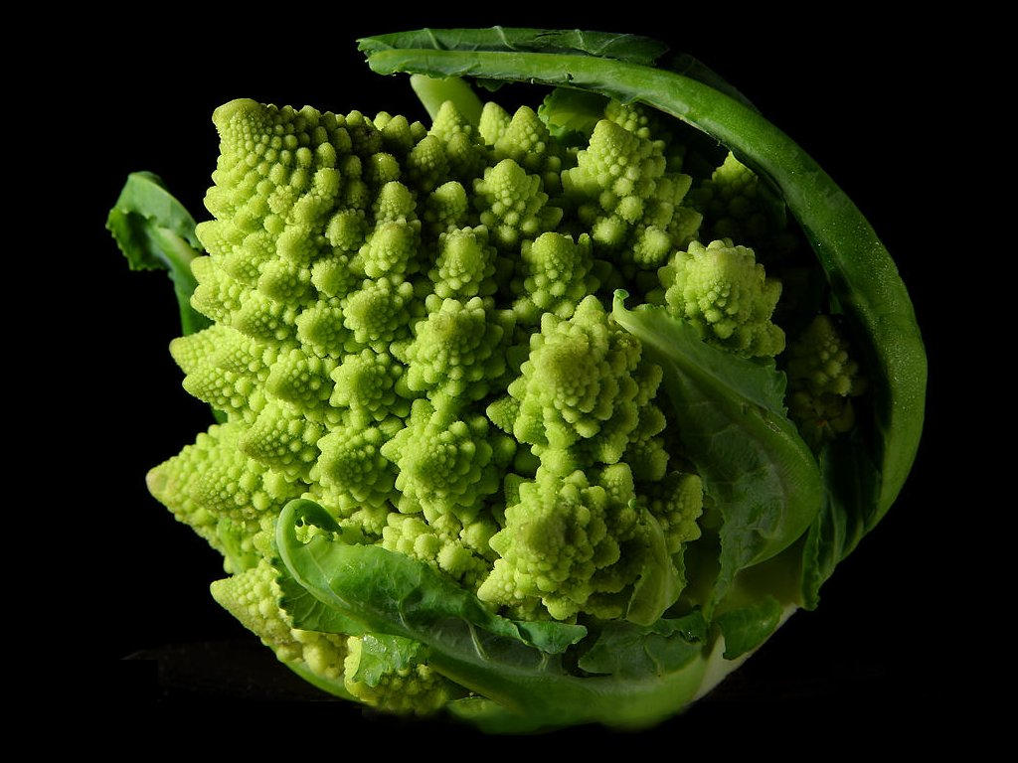
Self-Similarity
Romanesco broccoli

Slide 45

Self-Similarity

Slide 46
Fractals
Repeated self-similarity can be infinite.
Koch Snowflake

Slide 47
Landscapes
Add randomness to repeated pattern
landscapes.

Slide 48

Fractal Landscape
By The Ostrich - Own work, CC BY 3.0, https://commons.wikimedia.org/w/index.php?curid=4716597

Slide 49
Mathematically
A function defined in terms of itself.
Factorial:
Where:
Recursive Call.
Base case.

Slide 50
Recurrence Relationships
Fibonacci Numbers:
Where:
and
0, 1, 1, 2, 3, 5, 8, 13, 21, 34, 55, 89, 144, 233, 377, …
Recursive Calls.
Base cases.
0 | 1 | 1 | 2 | 3 | 5 | 8 | 13 | 21 | 34 | 55 | ? | ? | ? | ?

Slide 51
Computer Science
A function that calls itself.
Strongly related to mathematical definition.
Think about induction if you have taken a discrete math class.
Examples later

Slide 52
Factorial Flowchart
Self Recursion.
Base case.
Recursive Call.

Slide 53
Contrived Example
Indirect/Mutual Recursion.

Slide 54
Challenges
What if you do not include a base case or get to the base case?
Infinite recursion (think of an infinite loop)
Each time the recursive call occurs, a new stack frame is created…
Eventually, you will run out of memory!
Stack Overflow

Slide 55
Rules for Good Recursive Function
One or more base cases
Always returns without further recursion
One or more recursive function calls
Must get closer to base case
Don‘t forget to use the result of your recursive call!

Slide 56
Iteration
Recursion is a type of iteration!
Frequently, we use recursion because it looks more like the real problem (e.g. Fibonacci numbers).
Every time you call a function there is overhead. Creating stack frame, saving address to return to, etc.

Slide 57
Recursion vs. Looping
Generally, anything that is written recursively can be converted into a loop. Sometimes, the looping version is more efficient, sometime not.
You will see more useful applications of recursion in 221.
Tree and graph traversals, etc.
However, we want you to have some exposure now, so you do not have to learn it and tackle a harder problem at the same time.

Slide 58
Debugging
CSCE 121
J. Michael Moore

Slide 59
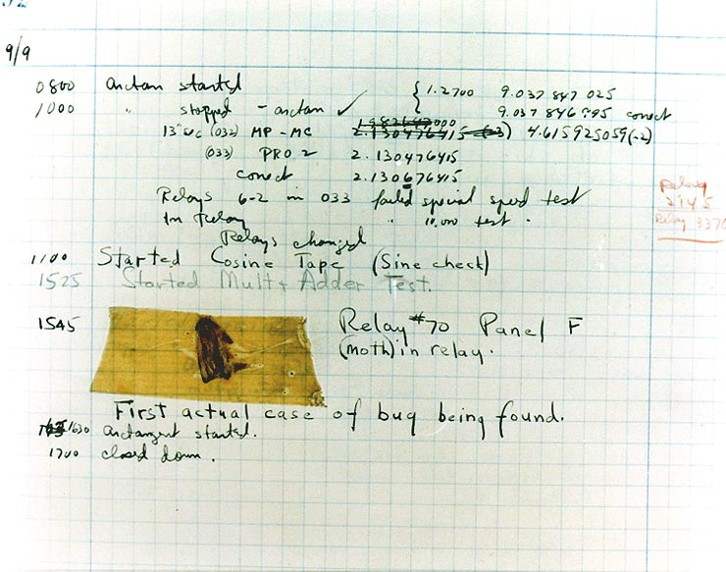
Early Bug

Slide 60
“If debugging is the process of removing software bugs, then programming must be the process of putting them in.”
Edsger Dijkstra

Slide 61
Debugging
Figuring out what is wrong with the code we wrote…
Analyze problem
Compare program results with hand executed results.
A couple of tools
Judicious use of print statements (i.e. cout)
Careful use of debugging tool.

Slide 62
Print Statements
Sometimes you have no choice.
Print out data at different points in the program.
Make certain you can determine where a particular output comes from.
Examples
Starting function X
Ending function X
Value(s) before processing/calculation
Value(s) after processing/calculation

Slide 63
Debuggers
Allow you to look at things while the program is running.
At any point in the program, you can see
the call stack.
Local variables and parameter values.

Slide 64
Breakpoints
Breakpoints can be placed on any executable statement in your code.
When the program executes, it will pause at a breakpoint.
You can look at variable values, etc.

Slide 65
Moving Through Code
Once stopped you can execute the code line by line.
Three options
Step Over
Move to the following statement. This will not enter any functions called on the current line (unless it finds another breakpoint in a function called before the next line).
Step Into
Go into the next function on the current line (if there is one.)
Note: functions may be nested.
Step Out
Stop going line by line in the current function and move to the next line of code in the calling function.

Slide 66
More?
There is a lot more out there regarding debugging.
However, these basics should help you tremendously as you gain experience programming.
If you find you need more, you can do some self teaching!

